Slide 1
StorePrint
Brand Store Management Platform
Unify · Audit · Operate · Grow
Executive Presentation | 2026
Brand Hub
GPS Auditing
Attendance
Roster
Store Ops
Analytics

Slide 2
The Challenge Facing Multi-Store Brands
⚡
Scattered Operations
📋
Manual Auditing
No single platform to manage compliance, attendance, assets and communication across all stores.
Paper-based checklists, inconsistent standards, no GPS verification or automated scoring.
👥
Attendance Gaps
💸
High SaaS Costs
No real-time visibility of who is on the floor. Clock-ins unverified and unreliable.
Global platforms charge $15–50/user/month with limited customisation or data control.

Slide 3
StorePrint
One platform. Seven modules. Complete store control.
📱
🖥️
⚙️
Mobile App
Admin Portal
API Backend
iOS, Android & Web
Staff, managers, auditors
Web dashboard
Full brand oversight
Self-hosted
Secure, scalable, yours
React Native · Node.js · PostgreSQL · Docker · Self-Hosted

Slide 4
Seven Integrated Modules
🗂️
✅
🕐
📅
Brand Hub
Auditing
Attendance
Roster
Digital asset library
GPS-verified compliance
Real-time presence
Shift management
🏪
📊
🔧
Store Ops
Analytics
Admin
6 operational modules
Performance insights
Full brand control
Each module is independently accessible via role-based permissions

Slide 5
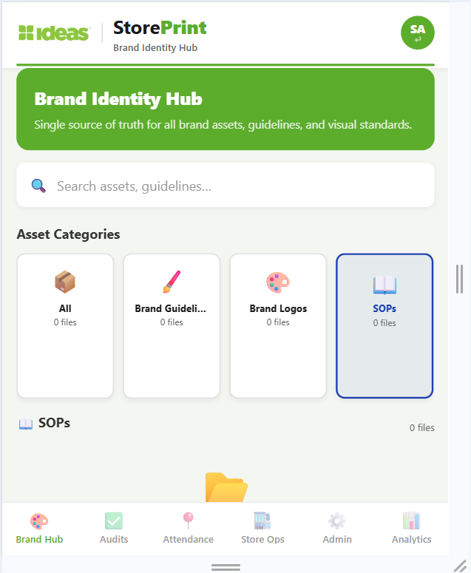
Brand Hub
Centralised Digital Asset Library
Brand guidelines, logos and campaigns in one place
Supports images, PDFs and documents
Brand Hub
Mobile App
Category-based organisation and search
One-tap WhatsApp & email sharing
Role-based access control per module

Slide 6
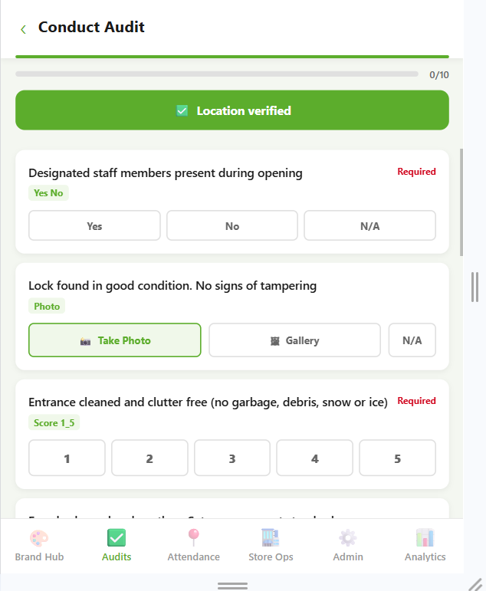
Store Compliance Auditing
GPS-verified, scored, automated
Smart Templates
1
Yes/No, Photo, Score 1–5, Free Text question types
Audit Form
Weighted Scoring
2
Each question carries a weight multiplier (1–5×)
GPS Enforcement
3
Auditor must be physically at store to submit
Auto Corrective Actions
4
Critical failures instantly create assigned action items

Slide 7
Audit Workflow
1
2
3
4
5
Admin Builds
Template
Auditor Selects
Store
Answers All
Questions
GPS Verified
Submission
Score & Report
Generated
⚖️
📍
⚡
Auto-weighted Scoring
GPS Timestamped
Instant Corrective Actions
Eliminates manual calculation
Every submission geo-verified
Critical fails auto-assigned

Slide 8
Field Attendance
Real-time GPS-verified presence management
GPS clock in/out — verified against store geofence
Live Presence
Ahmed R.
Present
Real-time live presence dashboard
Sara K.
Present
Late arrival & early exit detection
Bilal M.
Late
Full attendance log with timestamps
Nadia T.
Present
Usman F.
Absent
Status tracking: Present / Late / Absent
Rizwan S.
Present
4 Present
1 Late
1 Absent

Slide 9
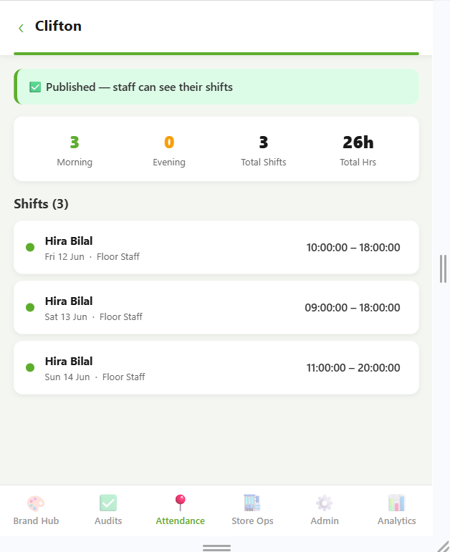
Roster Management
👔 For Managers
Create weekly/monthly rosters
Assign shifts: date, time, role, zone
Roster View
Draft-to-Publish workflow
Ahmed – Morning
Morning / Evening classification
🧑‍💼 For Staff
Bilal – Morning
My Shifts view — upcoming & past
Instant visibility on roster publish
Total hours display

Slide 10
Store Operations
Six operational modules in one tab
🖼️
📣
🪧
Visual Merchandising
Campaigns
Signage
Planogram compliance & VM tasks
Campaign rollout tracking
In-store signage compliance
🎓
🏗️
⭐
Training
Environment
Customer Experience
Staff onboarding & certification
Store condition checks
CX surveys & feedback

Slide 11
Analytics & Insights
📊
🕐
📈
✅
Audit Scores
Attendance
Benchmarks
Compliance
Compliance % by store
Real-time presence data
Compare stores side by side
Brand standard adherence
Store Compliance Scores — Last 30 Days
92%
95%
88%
87%
78%
71%
DHA
Clifton
Gulshan
PECHS
Saddar
Bahadurabad

Slide 12
Admin Web Portal
Complete brand oversight from a browser
👤 User Management
🏪 Store Management
📝 Audit Builder
Create users & assign roles
GPS geofence setup
Build templates with categories
Set granular permissions per module
Store hierarchy & zoning
Set question weights
Active/inactive status control
Staff assignment & status
Publish & manage templates

Slide 13
Granular Role-Based Access Control
Role
Brand Hub
Auditing
Attendance
Roster
Store Ops
Analytics
Admin
Super Admin
Full
Full
Full
Full
Full
Full
Full
Area Manager
Read
Full
Full
Full
Full
Full
—
Store Manager
Read
Full
Full
Full
Full
Read
—
Auditor
—
Full
Read
Read
—
Read
—
Field Staff
—
—
Full
Read
—
—
—
Customer Support
Read
—
—
—
Full
—
—
Full Access
Read Only
No Access

Slide 14
Global Market Comparison
StorePrint vs. established players — including AI-powered platforms
CLOSEST COMPETITOR
AI-POWERED
Wooqer
AI-powered frontline OS — audits, tasks, SensEye planogram AI, Lens SOP assistant, Wally co-pilot. 450+ enterprise clients worldwide.
Custom pricing
Est. $20–40/user/mo
Bindy
GoSpotCheck
Reflexis / Zebra
Retail audit & task mgmt
Field execution (now Movista)
Enterprise workforce mgmt
$25–40/user/mo
$30–50/user/mo
$20–35/user/mo
Tulip Retail
StoreForce
Axonify
Store ops — no GPS auditing
Retail workforce — scheduling only
Retail training — single module only
$40–60/user/mo
$15–25/user/mo
$10–20/user/mo
StorePrint | Self-Hosted | No Per-User Fees | 7 Integrated Modules | GPS-First Architecture

Slide 15
Feature Comparison
Feature
StorePrint
Wooqer
Bindy
GoSpotCheck
Reflexis
Tulip
GPS-Verified Auditing
✓
✓
✓
✓
✗
✗
Photo Evidence in Audits
✓
✓
✓
✓
✗
✗
GPS Clock In/Out
✓
✗
✗
✗
✓
✗
Roster / Shift Management
✓
✗
✗
✗
✓
✗
Digital Asset Library
✓
✗
✗
✗
✗
✓
Self-Hosted Option
✓
✗
✗
✗
✗
✗
Mobile + Web App
✓
✓
✓
✓
✓
✓
Corrective Action Mgmt
✓
✓
✓
✓
✗
✗
Custom Permissions
✓
✓
~
~
✓
~
No Per-User Fees
✓
✗
✗
✗
✗
✗
AI-Powered Features
✗
✓
✗
✗
✗
✗
~ = Limited | Wooqer AI features include SensEye planogram AI, Lens SOP assistant, and Wally co-pilot

Slide 16
Cost Benefit Analysis
50 users · 3-year total cost of ownership
Avg. Competitor
StorePrint
Your Savings
$15,000
$3,600
$34,200
Year 1 cost
Year 1 cost
3-Year savings
Avg $25/user/month
Infrastructure ~$300/mo
Year 1 saved: $11,400
50 users = $1,250/mo
No per-user fees ever
Year 2 saved: $11,400
Year 2: $15,000
Year 2: $3,600
Year 3 saved: $11,400
Year 3: $15,000
Year 3: $3,600
3-Year Total: $45,000
3-Year Total: $10,800
76% Cost Reduction
* Wooqer custom enterprise pricing est. $20–40/user/month — still 3–7× StorePrint infrastructure costs

Slide 17
Return on Investment
💰
⏱️
Direct Cost Savings
Time Savings
No $25–50/user/month licensing. For 50 users over 3 years: save $34,200+
GPS-verified auditing cuts admin time ~60%. Auto-scoring eliminates manual calculation.
📈
⚙️
Compliance Lift
Operational Efficiency
Real-time visibility drives store compliance. Issues corrected same-day, not next week.
Unified platform replaces 6+ separate tools. One login for all store operations.

Slide 18
Built for Real Users
📊
🏪
📱
Area Manager
Store Manager
Field Staff / Auditor
Monitors all stores from one screen. Reviews audit scores, tracks attendance across locations, manages rosters.
Creates rosters, conducts audits, views live presence. Manages day-to-day store operations end-to-end.
Clocks in with GPS, fills audits on phone, views their roster. Simple and focused mobile interface.

Slide 19
Mobile-First Design
Works on iOS, Android, and Web Browser
Cross-Platform
Role-Based Tabs
⚡
🔐
Expo/React Native — one codebase, three platforms
Locked modules shown clearly per user role
GPS-Native
Web App
📍
🌐
Camera, location, all device features built-in
Progressive Web App — works in any browser

Slide 20
Implementation & Onboarding
1
2
3
4
Week 1
Setup & Deploy
Week 2
Configure
Week 3
Onboard
Week 4
Go Live
Docker deployment
Add stores & users
Train managers
Full rollout
Database setup
Set permissions
Pilot audit run
All modules active
Initial configuration
Build audit templates
GPS calibration
Monitoring live
📅 Full deployment completed within 4 weeks · Dedicated onboarding support included

Slide 21
Why Choose StorePrint?
🔗
All-in-One Platform
7 modules replacing 6+ separate tools. One login, complete visibility.
💸
90% Cost Reduction
Self-hosted infrastructure only. No per-user licensing fees ever.
📍
GPS-First Design
Every clock-in, audit start, and submission geo-verified at the store.
🔒
Data Sovereignty
Your data on your servers. No third-party cloud. Full compliance control.
📈
Built to Scale
Docker architecture scales from 10 to 10,000 users with no cost increase.

Slide 22
StorePrint
One Platform. Complete Store Control.
Request a Demo
Review Technical Documentation
Start Pilot Deployment
Built for brands that demand excellence

